Slide 1
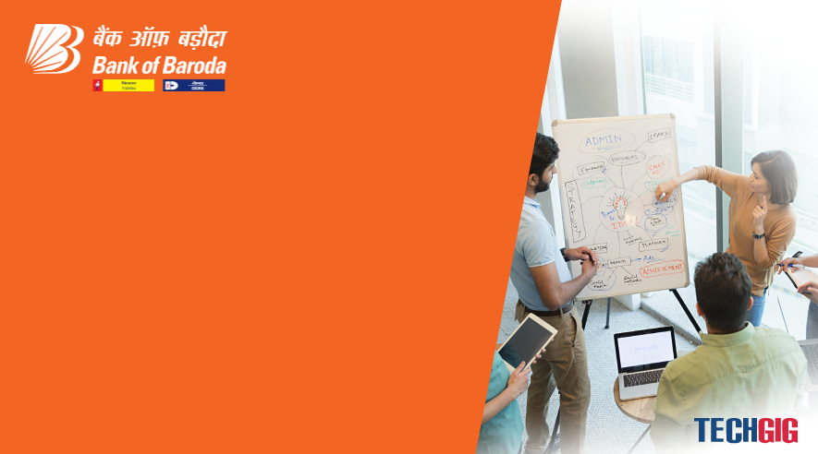

Bank of Baroda Hackathon - 2022
Technology Partner
Your Team Name : AI Warrior
Your team bio : I am a Data Scientist who loves to solve interesting problems
Date :20/09/2022

Slide 2
Problem Statement?
Why did you decide to solve this Problem statement?
I am a data scientist with 12 year experience in data science field. I love to solve to interesting data science problem including this one. I have experience working with computer vision problems and cloud deployment. So, working on this interesting problem.

Slide 3
User Segment & Pain Points
Which user /advertiser segment would be early adopter of your product & why?
This question doesn’t sound relevant

Slide 4
Pre-Requisite
What are the alternatives/competitive products for the problem you are solving?

Slide 5
Azure tools or resources
Azure tools or resources which are likely to be used by you for the prototype, if your idea gets selected Azure Container Azure Functions Azure Functional flow Kubernetes Azure DB

Slide 6
Any Supporting Functional Documents
Present your solution, talk about methodology, architecture & scalability
So, the idea is to use the CCTV feed to mark individual customer as unique entity and each functional unit as a business zone. Next thing is to measure the time spent by each entity in different zone & what’s their frequency of visit.
To identify the known facilitator, we will train the ML algorithm to exclude the entities with the Bank of Baroda tag.
The necessary information then processed and saved as a transaction record in the db detailing all the tracking KPIs.
For validation and False positive detection, first few months requires manual validation to cross verify AI output by the functional teams. After successful launch of pilot, later rounds could be an automated reinforcement learning learnt from the inputs from the experts.

Slide 7
Key Differentiators & Adoption Plan
How is your solution better than alternatives and how do you plan to build adoption?
My solution uses the best in the market cloud services to assess & analyze the video feed realtime.
The key is iterative learning process where a reverse fed is given back to the software for reinforcement learning.

Slide 8
GitHub Repository Link & supporting diagrams, screenshots, if any
How far it can go?

Slide 9
Thank You
Team member names

